Slide 1
CS 161 Midterm 2 Review
Grant Ho, Frank Li, Rishabh Poddar

Slide 2
RSA (Confidentiality)
Alice’s key pair
Public key = (n, e)
Private key = d
e, d such that
X = X^{e.d} mod n

Slide 3
RSA (Confidentiality)
Alice’s key pair
Public key = (n, e)
Private key = d
e, d such that
X = X^{e.d} mod n
Pick primes p, q
n = pq
φ(n) = (p-1)(q-1)
Pick 2 < e < φ(n)
Compute d such that
e.d = 1 mod φ(n)

Slide 4
RSA (Confidentiality)
Alice’s key pair
Public key = (n, e)
Private key = d
Bob encrypts M using Alice’s public key
C = Me mod n
Sends C to Alice
e, d such that
X = X^{e.d} mod n

Slide 5
RSA (Confidentiality)
Alice’s key pair
Public key = (n, e)
Private key = d
Bob encrypts M using Alice’s public key
C = Me mod n
Sends C to Alice
Alice decrypts C using her private key
M = C^{d} mod n
e, d such that
X = X^{e.d} mod n

Slide 6
RSA (Integrity + Authentication)
Alice’s key pair
Public key = (n, e)
Private key = d
e, d such that
X = X^{e.d} mod n

Slide 7
RSA (Integrity + Authentication)
Alice’s key pair
Public key = (n, e)
Private key = d
Alice signs M using her private key
S = H(M)^{d} mod n
Publishes (M, S)
e, d such that
X = X^{e.d} mod n

Slide 8
RSA (Integrity + Authentication)
Alice’s key pair
Public key = (n, e)
Private key = d
Alice signs M using her private key
S = H(M)^{d} mod n
Publishes (M, S)
Anyone can verify signature using Alice’s public key
H(M) = S^{e} mod n
e, d such that
X = X^{e.d} mod n

Slide 9
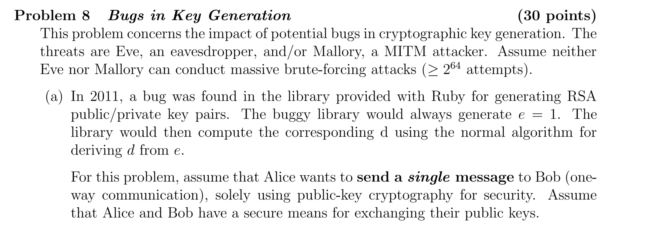
Crypto (Sp13 - Final)

Slide 10
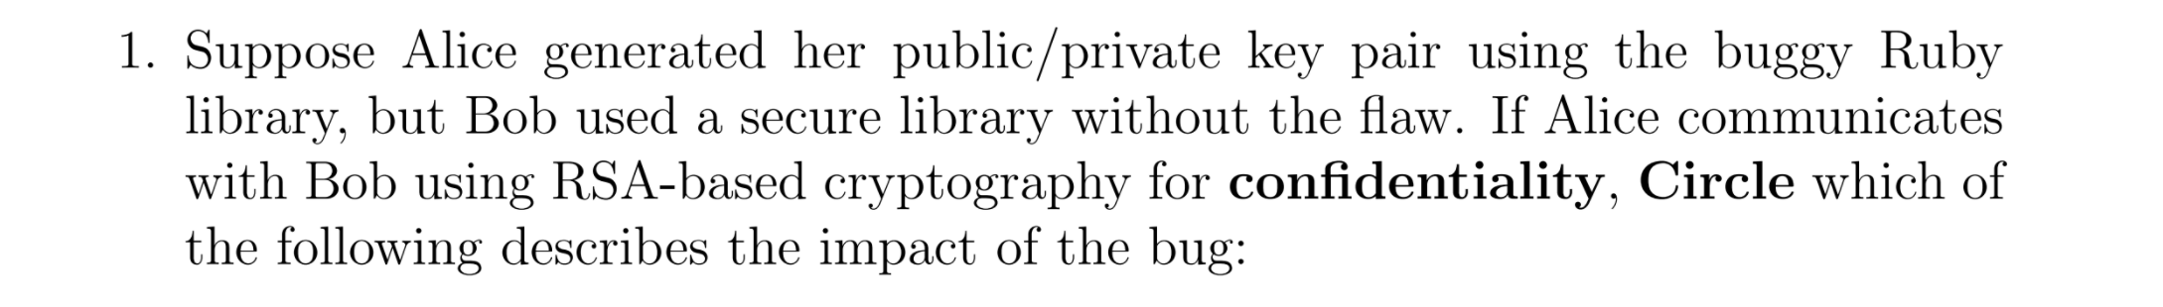
No effect in this scenario
Bob can read Alice’s messages, but so can Eve
Bob will not be able to read Alice’s messages

Slide 11
No effect in this scenario
Bob can read Alice’s messages, but so can Eve
Bob will not be able to read Alice’s messages
Alice’s keys : n_{A}, e_{A} and d_{A}
If e_{A} = 1, then d_{A} = 1
Bob’s keys : n_{B}, e_{B} and d_{B}
A → B : M^{eB} mod n

Slide 12
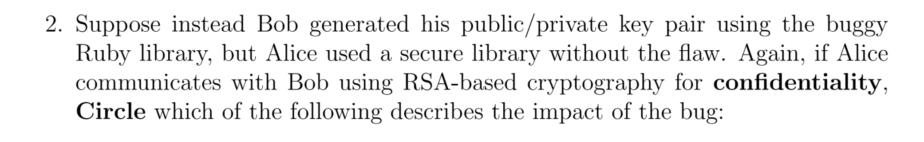
No effect in this scenario
Bob can read Alice’s messages, but so can Eve
Bob will not be able to read Alice’s messages

Slide 13
Alice’s keys : n_{A}, e_{A} and d_{A}
Bob’s keys : n_{B}, e_{B} and d_{B}
If e_{B} = 1, then d_{B} = 1
A → B : M^{eB} mod n
= M¹ mod n
No effect in this scenario
Bob can read Alice’s messages, but so can Eve
Bob will not be able to read Alice’s messages

Slide 14
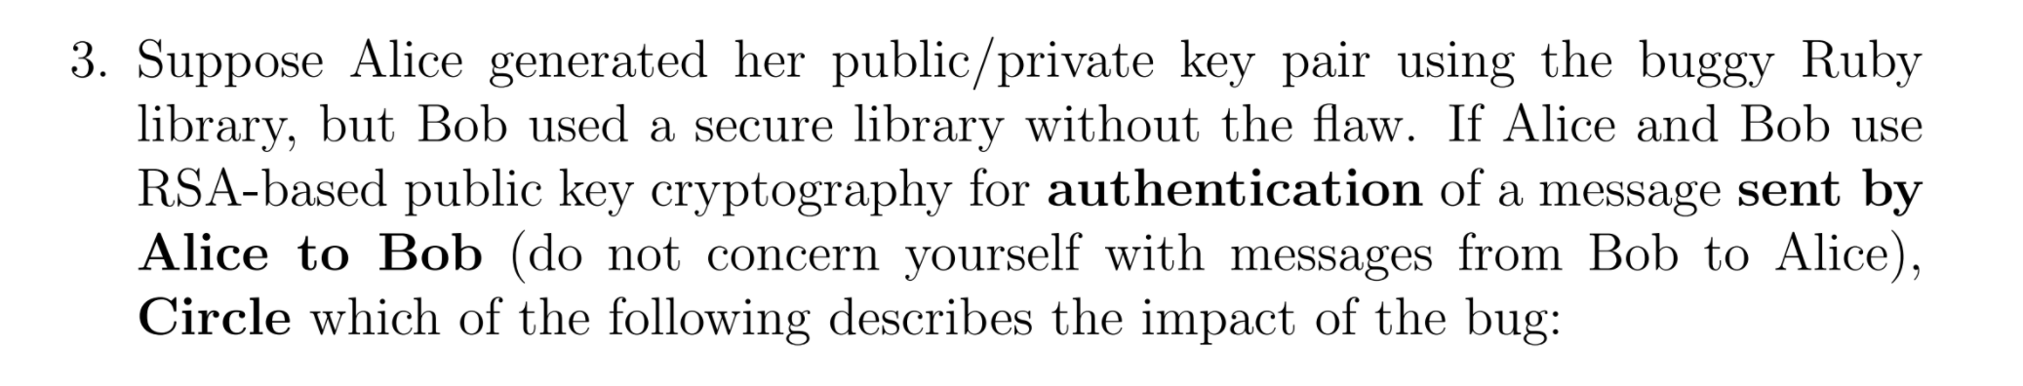
No effect in this scenario
Alice’s message will not verify to Bob as properly signed
Mallory can construct a message that appears to have a valid signature from Alice

Slide 15
Alice’s keys : n_{A}, e_{A} and d_{A}
If e_{A} = 1, then d_{A} = 1
Bob’s keys : n_{B}, e_{B} and d_{B}
A → B : M, S
S = H(M)^{dA} mod n
= H(M)¹ mod n
Mallory can create (M’, S’)
S’ = H(M’) mod n
No effect in this scenario
Alice’s message will not verify to Bob as properly signed
Mallory can construct a message that appears to have a valid signature from Alice

Slide 16
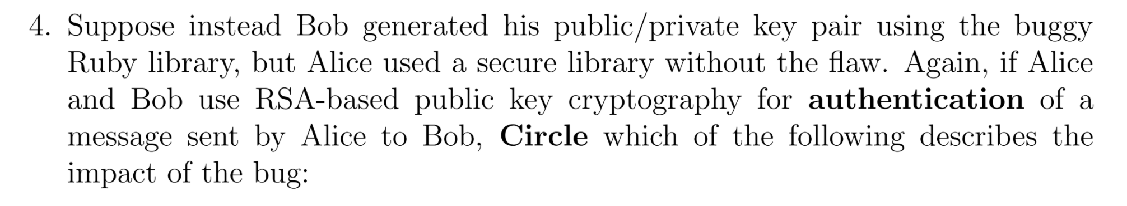
No effect in this scenario
Alice’s message will not verify to Bob as properly signed
Mallory can construct a message that appears to have a valid signature from Alice

Slide 17
Alice’s keys : n_{A}, e_{A} and d_{A}
Bob’s keys : n_{B}, e_{B} and d_{B}
If e_{B} = 1, then d_{B} = 1
A → B : M, S
S = H(M)^{dA} mod n
No effect in this scenario
Alice’s message will not verify to Bob as properly signed
Mallory can construct a message that appears to have a valid signature from Alice

Slide 18
Crypto (Sp13 - Final)
1
Broken
Confidentiality
Integrity
Authentication
Non-repudiation
None

Slide 19
Crypto (Sp13 - Final)
1
Broken
Confidentiality
Integrity
Authentication
Non-repudiation
None
Bob needs Alice’s private key to decrypt

Slide 20
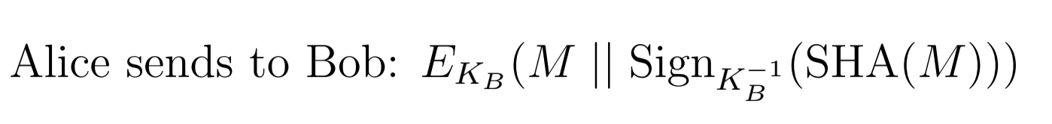
Crypto (Sp13 - Final)
2
Broken
Confidentiality
Integrity
Authentication
Non-repudiation
None

Slide 21
Crypto (Sp13 - Final)
2
Broken
Confidentiality
Integrity
Authentication
Non-repudiation
None
Alice needs Bob’s private key to sign

Slide 22
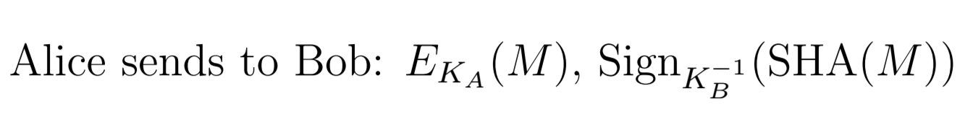
Crypto (Sp13 - Final)
3
Broken
Confidentiality
Integrity
Authentication
Non-repudiation
None

Slide 23
Crypto (Sp13 - Final)
3
Broken
Confidentiality
Integrity
Authentication
Non-repudiation
None
Bob needs Alice’s private key to decrypt
Alice needs Bob’s private key to sign

Slide 24
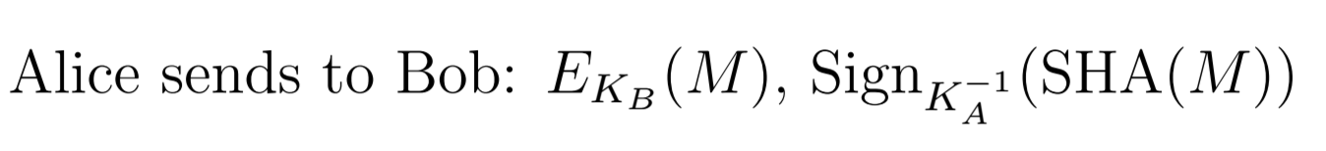
Crypto (Sp13 - Final)
4
Broken
Confidentiality
Integrity
Authentication
Non-repudiation
None

Slide 25
Crypto (Sp13 - Final)
4
Broken
Confidentiality
Integrity
Authentication
Non-repudiation
None

Slide 26
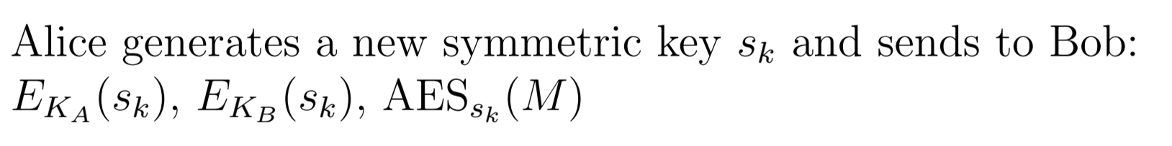
Crypto (Sp13 - Final)
5
Assume M is single block msg
Broken
Confidentiality
Integrity
Authentication
Non-repudiation
None

Slide 27
Crypto (Sp13 - Final)
5
Broken
Confidentiality
Integrity
Authentication
Non-repudiation
None
Only encryption; does not provide integrity or authentication
Alice doesn’t sign, hence no non-repudiation

Slide 28
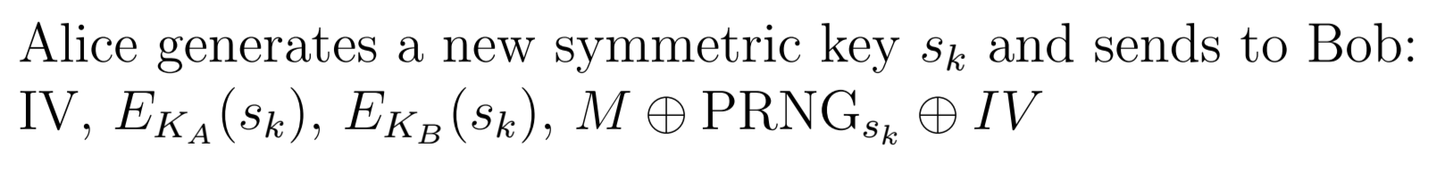
Crypto (Sp13 - Final)
6
Broken
Confidentiality
Integrity
Authentication
Non-repudiation
None

Slide 29
Crypto (Sp13 - Final)
6
Broken
Confidentiality
Integrity
Authentication
Non-repudiation
None
Only encryption (stream cipher); does not provide integrity or authentication
Alice doesn’t sign, hence no non-repudiation

Slide 30
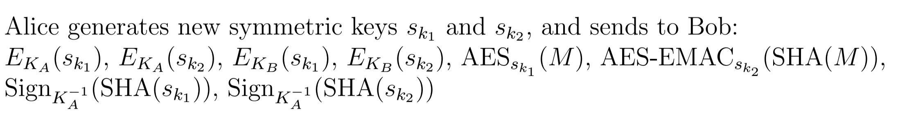
Crypto (Sp13 - Final)
7
Broken
Confidentiality
Integrity
Authentication
Non-repudiation
None

Slide 31
Crypto (Sp13 - Final)
7
Broken
Confidentiality
Integrity
Authentication
Non-repudiation
None
Encryption provides confidentiality
MAC provides integrity + authentication
Alice doesn’t sign ciphertext, hence no non-repudiation

Slide 32
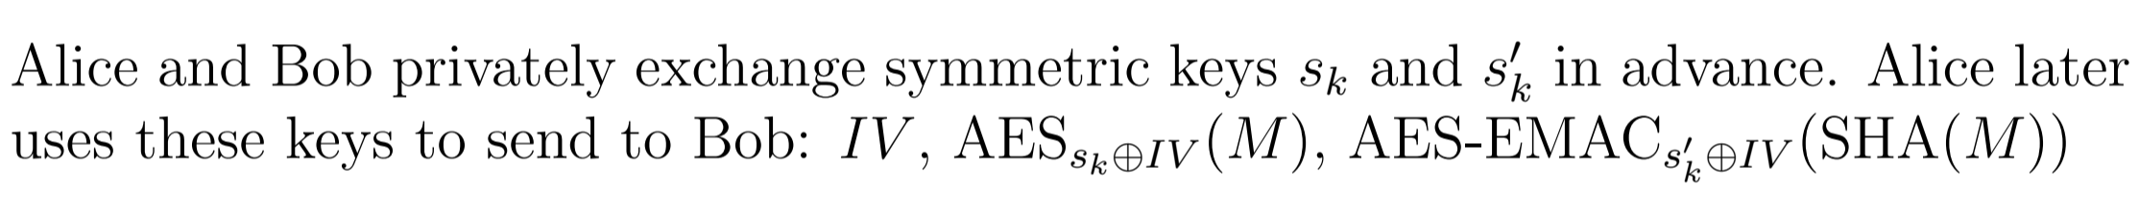
Crypto (Sp13 - Final)
8
Broken
Confidentiality
Integrity
Authentication
Non-repudiation
None

Slide 33
Crypto (Sp13 - Final)
8
Broken
Confidentiality
Integrity
Authentication
Non-repudiation
None
Encryption provides confidentiality
MAC provides integrity + authentication
Alice doesn’t sign, hence no non-repudiation

Slide 34
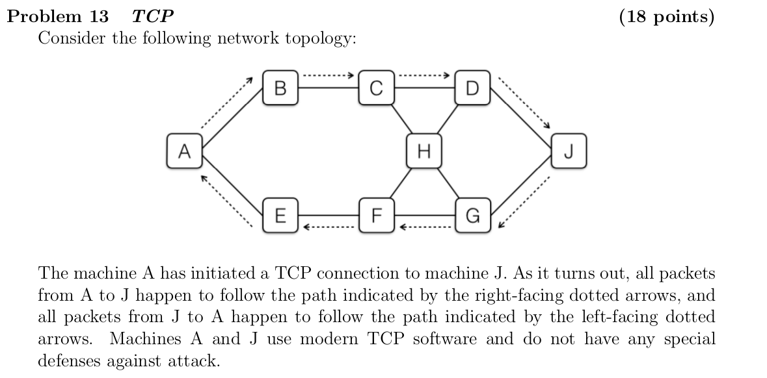
TCP Injection Practice Question (SP 14 - Final)

Slide 35
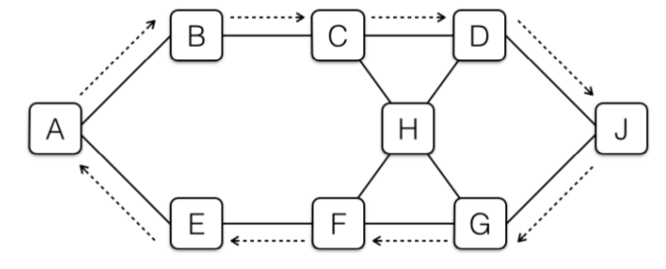
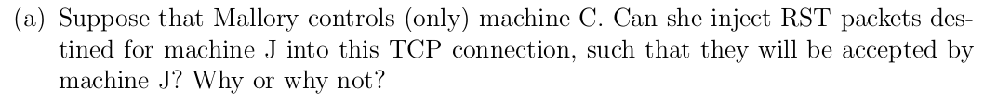
TCP Injection Practice Question

Slide 36
TCP Injection Practice Question
Yes, she’s on-path and can see A’s TCP seq #, so can inject a valid forged RST packet to J.

Slide 37
TCP Injection Practice Question

Slide 38
TCP Injection Practice Question
Yes, she’s on-path and can see A’s TCP seq #, so can inject valid forged data packet to J.

Slide 39
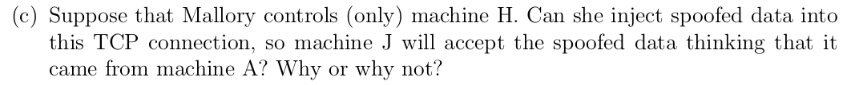
TCP Injection Practice Question

Slide 40
TCP Injection Practice Question
No, she’s off-path and must blindly guess A’s TCP seq #.

Slide 41
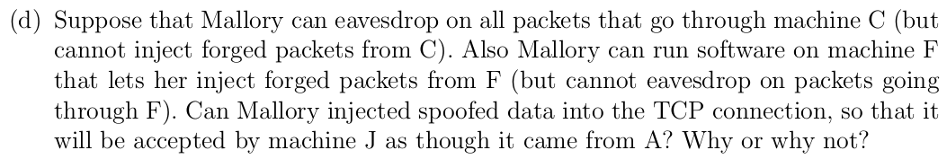
TCP Injection Practice Question

Slide 42
TCP Injection Practice Question
Yes, she’s on-path and can see A’s TCP seq # at C, and can inject spoofed data packets with correct seq #s from F to J.

Slide 43
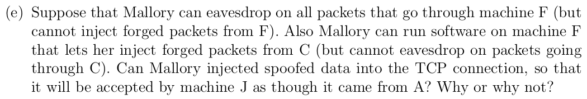
TCP Injection Practice Question
C

Slide 44
TCP Injection Practice Question
Yes, b/c she’s on-path, and can still see seq #s in both directions at F (remember that the TCP acknowledgement field has the seq # of the receiver). So valid spoofed data packets can be injected at C sent to J.

Slide 45
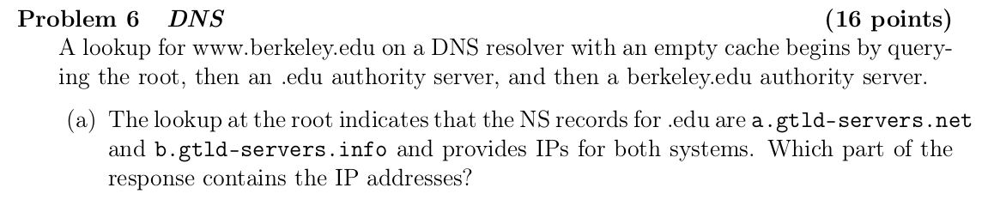
DNS Practice Question (FA16 - Midterm 2)

Slide 46
DNS Practice Question
The additional records

Slide 47
DNS Practice Question

Slide 48
DNS Practice Question
Yes, it’s in the root’s bailiwick.

Slide 49
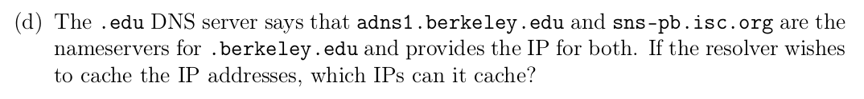
DNS Practice Question

Slide 50
DNS Practice Question
Only the IP of adns1.berkeley.edu is saved, since the other is not in the .edu nameserver’s bailiwick.

Slide 51
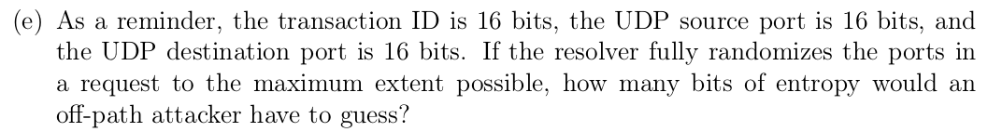
DNS Practice Question

Slide 52
DNS Practice Question
32 bits, since you don’t randomize the destination port.

Slide 53
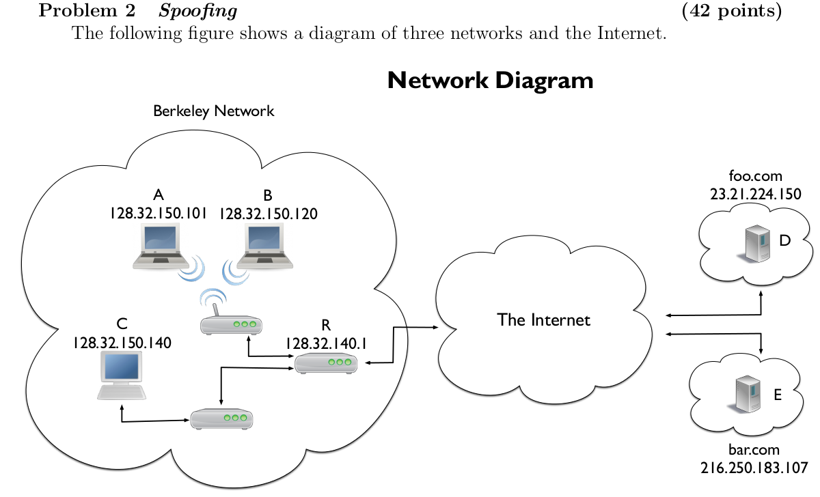
Spoofing (SP13 - Midterm 1)

Slide 54
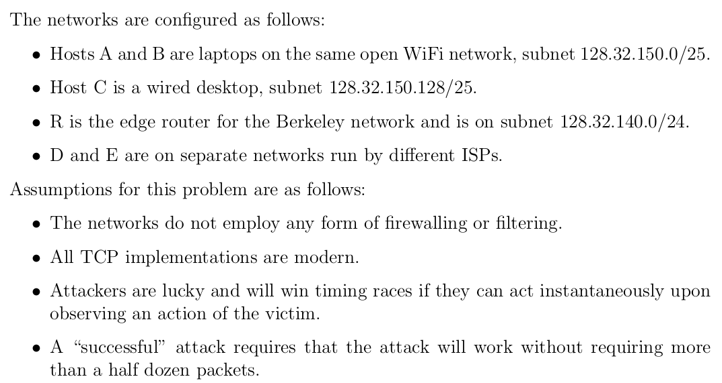
Spoofing

Slide 55
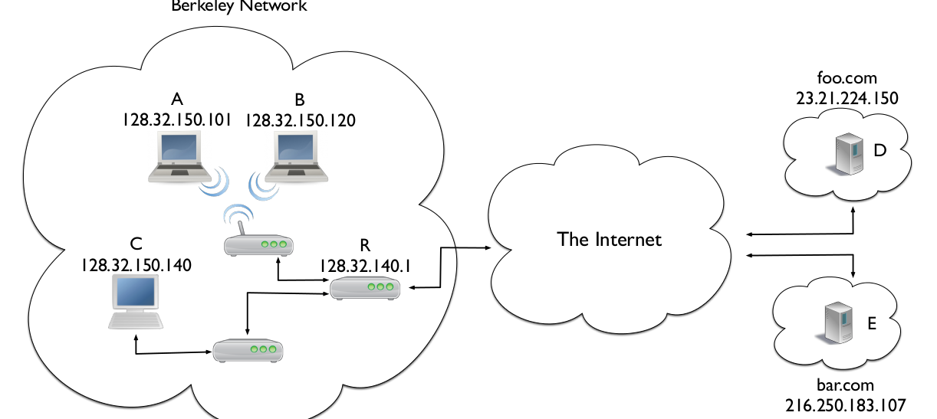
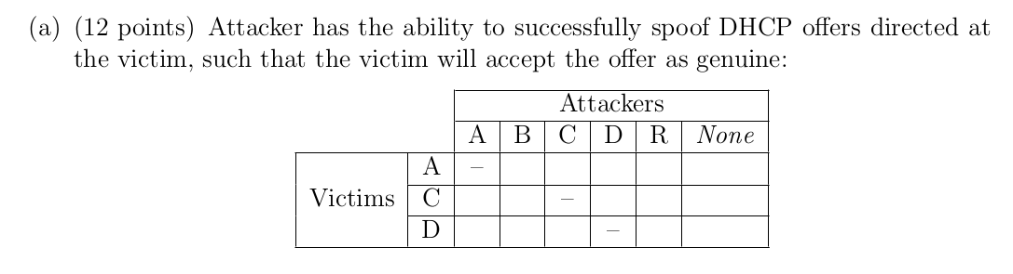
Spoofing

Slide 56
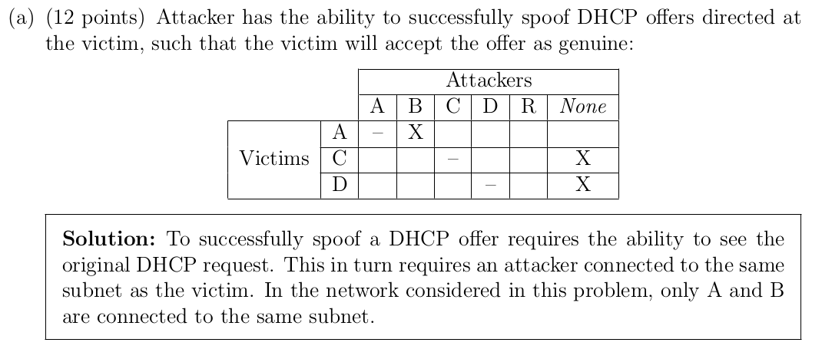
Spoofing

Slide 57
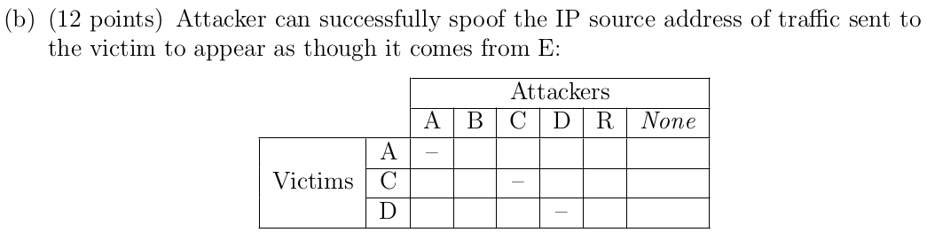
Spoofing

Slide 58
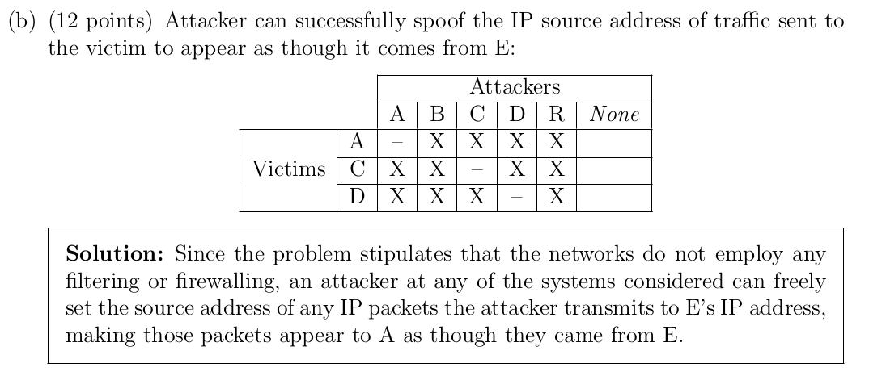
Spoofing

Slide 59
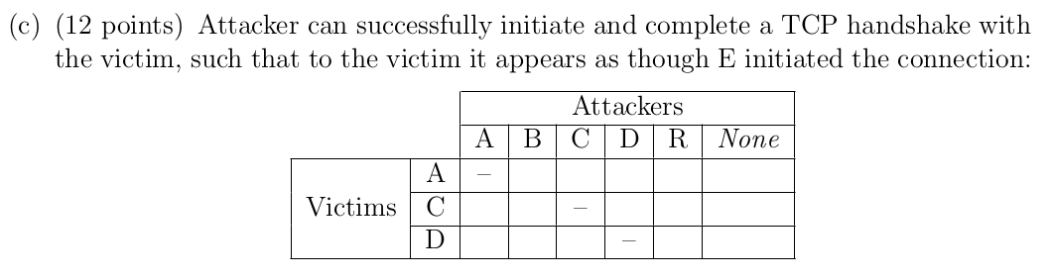
Spoofing

Slide 60
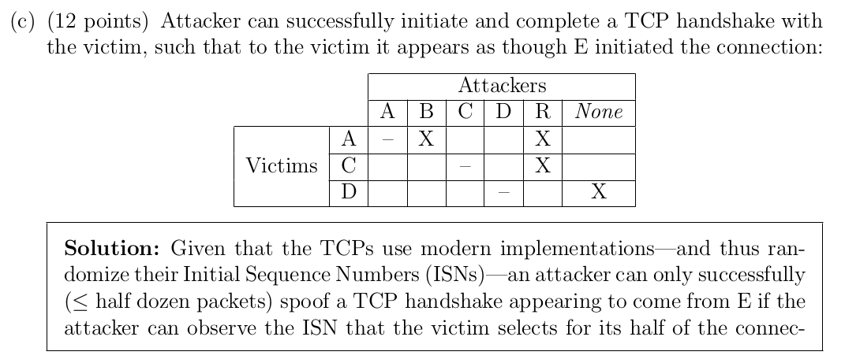
Spoofing

